Slide 1
An Illusion of Democracy?
Thomas R. Lawson, Ph.D., Hon. D.Sc.
Professor and Director of International Programs
University of Louisville
Louisville, Kentucky USA

Slide 2
Democracy is under assault
Based upon ignorance
Centered on negativism
Fed by recession
Stoked by self-centeredness
Expressed through fear and anger
Concentrated on winning

Slide 3
Traditional bastions of democracy
Democratic governments
Universities
Rectifying misconceptions and challenging misperceptions
Inclusion has been the method
Rational and critical thinking has been the mantra

Slide 4
Role
In appears that in the recent past universities in developed countries have not played a major role in dispelling misconceptions compared to universities in developing nations
Is it easier for universities to engage in democracy building than in democracy maintaining?
It seems that universities have not been engaged in negating false propositions and arguments …based on fear and anger that promote “otherness” and “isms”.

Slide 5
Observations about democratic “Othering”
Politics (world-wide) today is aimed at creating differences
Obtaining political power is accomplished by promoting polarization that appeals to both personal and group security
Polarization creates greater difference and more “others”
Even within traditional political parties there is evidence of internal separation from moderates to extremists

Slide 6
Today there is a more narrow political definition of oneself/group
We shed parts of our self that are inconsistent with our self image
We know who we are because “we are not them”
Typical in western culture is a history of a collective narrative that distinguishes a particular cultural/societal group from their neighbors – creating “otherness”

Slide 7
Not Me and Diversity
Rejection of all that is not me.. Is a rejection of diversity
The “others” characteristics are always less than one’s own characteristics with major categories of lesser being race, class, gender, religion etc.
Such characteristics are never totally permanent and serious crisis and periods of social anxiety force groups to redefine “others” hence today’s situation of more people that are not like me and more blame on those “not like me”

Slide 8
Dependent on the “Other”
A continuing need for the existence of the “other .. For example a different race available to be prejudice against
“False Democracy” allows “others” into the group and positions of power, then force failure to prove that “others” are not worthy to be part of us…women…other races etc.

Slide 9
The bifurcated and somewhat confusing role of “democratic othering”
Exclusionary – to make the other as unlike us as possible
Incorporating – to assimilate and deny existence and voice
In the assault on democracy it appears in “wooing” a group of voters (typically “others” into your own group then not allowing them to voice or form the group’s agenda is a classic example..

Slide 10
Democratic inconsistencies
Defining characteristics of the other group does not need to be consistent except to provide ways to disparage and obtain power
Example:
More government restrictions will hurt employment
More government restrictions will result in more government employees

Slide 11
Where are the “others”?
Both without and within as noted earlier with political parties
Lack of “good society” without = barbarism
Lack of “good society within = decadence
The increase of fear of the outer other after 9/11 – terrorist… creates greater fear of the inner other - illegal immigrants
One can see the foundation of alienation, prejudice and violence to others as it is occurring in America today

Slide 12
Success?
Today in the US it seems that money and tangible goods rather than wisdom mark successful people
If you do not have “sufficient” money or goods then you are a “failure”.
“Failures” can be easily recruited into one political group by focusing the blame of the individual’s economic condition on the political actions of the opposing political group.

Slide 13
Source: Emannuel Saez, http://emlab.berkeley.edu/users/saez/

Slide 14
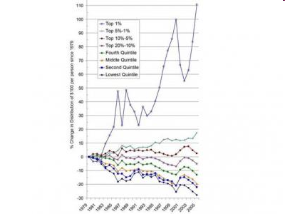
Top 1%
Normalized to 1979, the top 1% have seen their share of America‘s income more than double. The bottom 90% have seen their portion
shrink. Source: Afferent Input
The Rest
Read more:
http://www.businessinsider.com/15-charts-about-wealth-and-inequality-in-america-2010
-4#if-you-arent-in-the-top-1-then-youre-getting-a-bum-deal-15#ixzz0mv6vR7BE

Slide 15
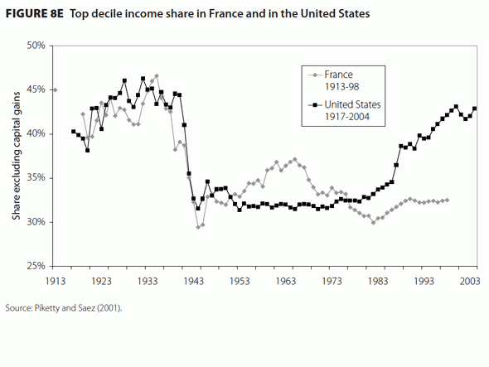
Source: http://www.businessinsider.com/15-charts-about-wealth-and-inequality-in-america-2010-4#the-income-gap-is-not-growing-in-other-countries-like-france-13

Slide 16
Results of the Change to a Consumer Society
By the 1970’s the US had become a Consumer Society with people wanting more service and goods.
Now for most of the society they did not have to fight to obtain material and consumer goods… rather the began to fight to keep what they had.
A fight to keep rather than a fight to get

Slide 17
American Household Adaptations to Pressures on Standard of Living
Add women in the workforce
Decrease the savings rate
Increase household debt

Slide 18
Democracy in a Fearful Society
Democracy ….Valuing the discourse of diversity and dissent creates ongoing change
“Otherocracy”….. Silencing the voice of variance promotes the status quo

Slide 19
Thoughts on Sustaining Democracy in a University Setting
Confront bias at all levels ….including our own and others that match ours
Continuously challenge our own ideology and have colleagues and students challenge it as well.. because it can become a model for students and the community

Slide 20
Thoughts
Create an atmosphere for questioning assumptions and the reasons for making such assumptions
Feelings and beliefs about “others” can be changed through positive interactions
Thus, opportunities where positive interactions between disparate political groups can take place should be promoted.

Slide 21
Thoughts
Facts and rational arguments are often not successful in challenging tightly held political ideologies, assumptions and inconsistencies
Experiential and not factual methods are typically more successful

Slide 22
Thoughts
Universities seem quick to rush students into graduation, jobs and professions.
When universities are operated as a business “lingering” (number of years to graduation) or “breadth” seen as a waste of time and money.
Entering and incorporation into a profession too early may inhibit interaction with others not like self… promoting again the “not like us” political insulation

Slide 23
Thoughts
Personally I was recently reminded about the tremendous value of reflection as a means to review situations and actions… a most needed activity in a functional democracy
Example: Teaching a doctoral statistics course with a student in the class from China.

Slide 24
Thoughts
More engagement outside the university. For example working with the local educational system from pre-school to university in promoting democracy and reducing “political othering”. Examples: mock congresses, teacher, adults and children engaging in exercises in democratic activities
Utilization and understanding of technology is important in working with students, so that we are not placed into the “other category” immediately
Promote sharing across boundaries not within boundaries

Slide 25
Thoughts
Creating polarization and negativity is one of the most strident ways to reduce democracy thus we at universities as bastions of democracy must successfully confront it
The function of scholarship and teaching is not related to our universities………
Rather it is related to our purpose and commitment to promote and sustain democracy

Slide 26
Concerns at University
Have we relinquished our role without a whimper as “thought shapers”?
Have we allowed the “mind benders” to reduce rational and democratic thought?

Slide 27
“OTHERS”
One needs to look at what is happening to the traditional “others” in America
Major Changes are taking place!!!!!!!!!!

Slide 28
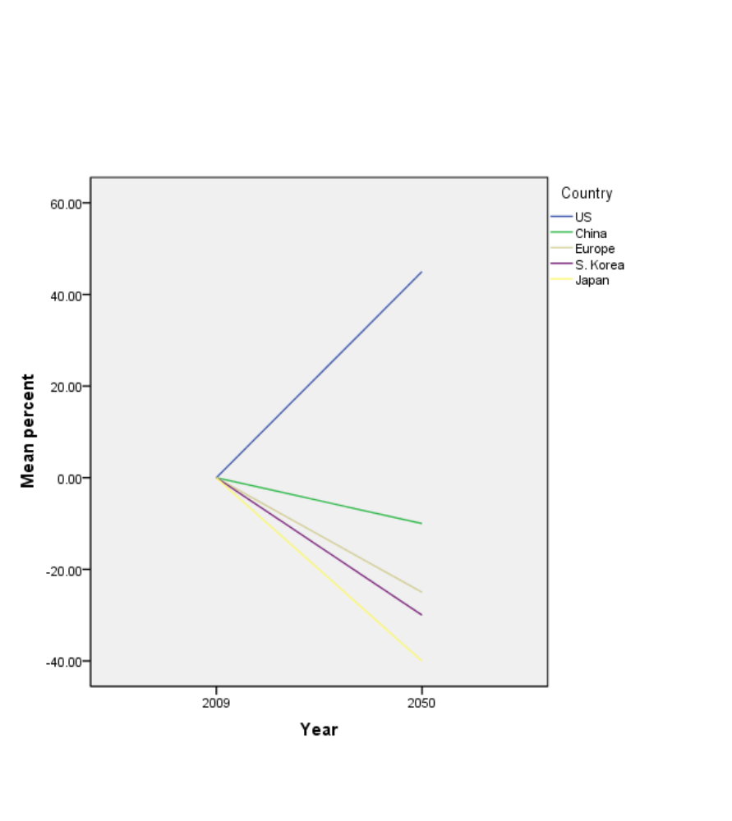
Change in Age 15-64
2009 - 2050

Slide 29
Immigration-Emigration
2010 to 2050
Estimates from U.N. in thousands
United States + 1080
Canada +214
United Kingdom +174
Spain +170
Italy +159
Mexico - 334
China -309
India -252
Philippines - 175
Pakistan -161

Slide 30
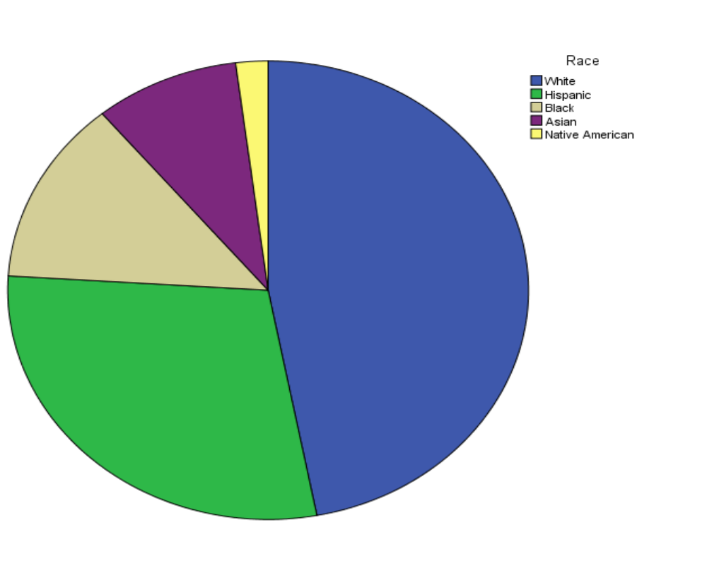
Percent of Population in America 2050
White = 47%
Hispanic = 29%
Black = 13%
Asian = 9%
Native American = 2%

Slide 31
DIVERSITY
By 2050 American will not have a
White Majority
No other advanced populous country will be
AS DIVERSE AS THE U.S.

Slide 32
Immigrants and Business
In America between 1990 and 2005 immigrants started…… 25% of all venture-backed public companies!
Large American companies are also increasingly led by people
born in foreign countries, INCLUDING 15 of the Fortune 500 companies CEOs in 2007!!

Slide 33
Voting in US and Hungary
Bodi’s paper notes that Hungarians vote more when there is a close to home election.. In a rural village or local mayor than national or EU elections.
Elections in the US are typically the same EXCEPT… this time when there was great concern about the leadership of the country and we had one of the largest percent of voters who went to vote in present history.

Slide 34
Election 2012
Fear and “othering” has 2 sides
Conservative white males can be see as others by minorities and females
The over 1 billion dollars spent on negative adds did not seem to make any difference
What made the difference was a person going door to door to get people who are like them to vote!

Slide 35
“others together win”
Jewish 69% Obama
Young (18-29) 60% Obama (19% of total vote)
Hispanic 71% Obama (17% of total vote)
Asian 70% Obama (3% of total vote)
African Am. 93% Obama (15% of total vote)
Women 55% Obama
Single Women 67% Obama
White Men 63% Romney

Slide 36
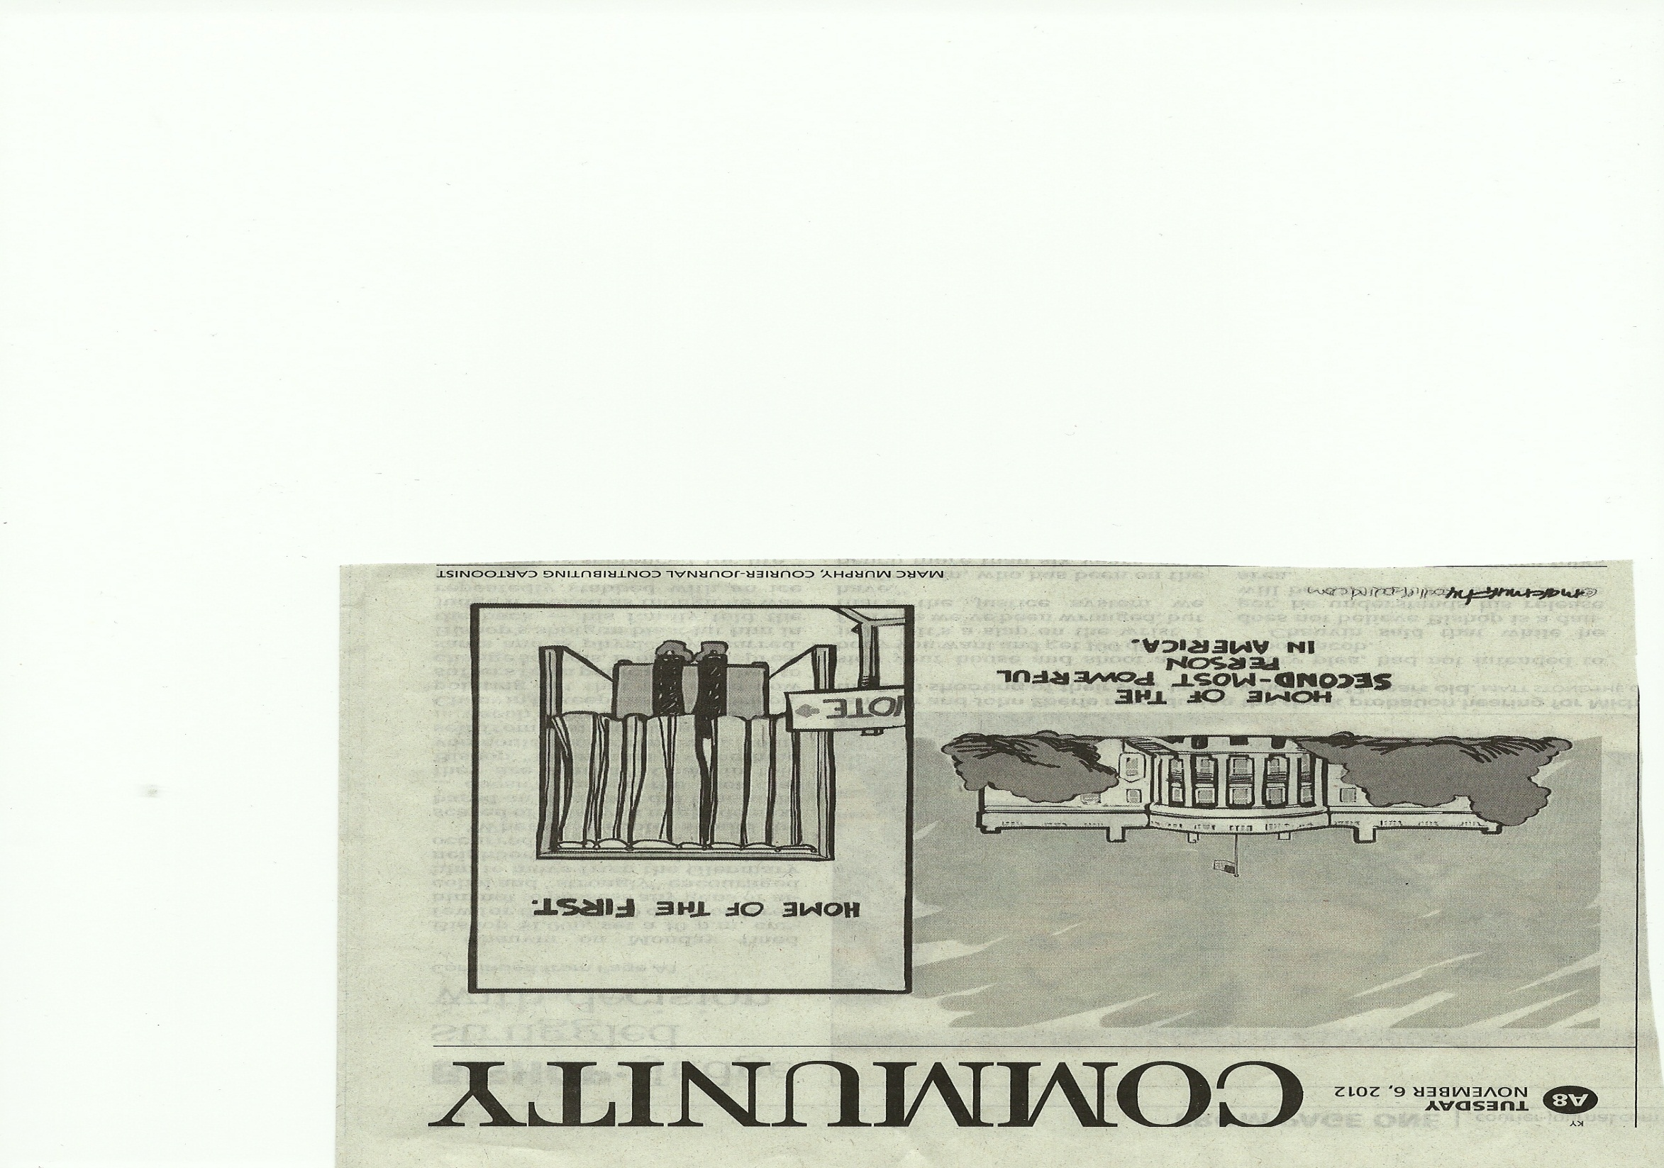

Slide 37
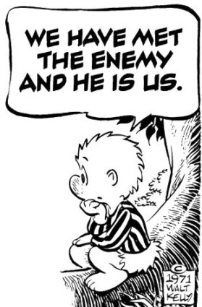
HAVE WE?

