Slide 1
The times they are a changin’
Community
Social Interaction
Civic Duty
OR
Individualism
Narcissism
Fame Chasers

Slide 2
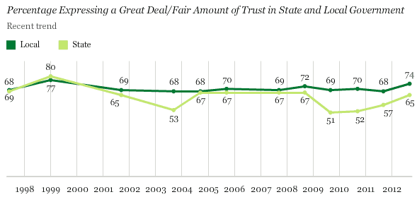
Local Engagement
National Dis-Interest

Slide 3
AMERICANS DO NOT TRUST THE OTHER PERSON
2013 ONLY 1/3 OF AMERICANS SAY MOST PEOPLE CAN BE TRUSTED
1972 ½ SAID MOST PEOPLE CAN BE TRUSTED
2/3 OF ALL AMERICAN SAY YOU CANT BE TOO CAREFUL DEALING WITH PEOPLE

Slide 4
TRUST AMERICAN STYLE
AMERICANS ARE SUSPICIOUS OF EACH OTHER IN EVERY DAY ENCOUNTERS
ONLY …30% TRUST THE CLERKS WHO SWIPE THEIR CREDIT CARDS
ONLY …..30 % TRUST OTHER DRIVERS

Slide 5
SOCIAL TRUST
BRINGS GOOD THINGS
EASIER TO COMPROMISE – MAKE A DEAL
WORK WITH OTHERS FOR THE COMMON GOOD
PROMOTE ECONOMIC GROWTH BY WORKING TOGETHER

Slide 6
DISTRUST
PROMOTES CORRUPTION
TAKE TIME TO COUNT CHANGE BECAUSE DON’T TRUST CLERK
100 PAGE LEGAL CONTRACTS
COMMUNITIES WITH GATES AROUND THEM
BASIS FOR TRUST IS BUILT BY MID 20’S AND DOES NOT CHANGE

Slide 7
BABY BOOMERS AND TRUST
EACH GENERATION SINCE THE BOOMERS HAS LESS TRUST.
“GOING ALONE” RESULTES IN 2 DECADES OF DECLINING SOCIAL TRUST AND SOCIAL CAPITAL.
AMERICAN HAVE ABANDONED SOCIAL ACTIVITIES AND HAVE FEWER MEETINGS

Slide 8
GOING IT ALONE
LESS TRUSTFUL THAN THE LONG CIVIC GENERATION THAT WAS BORN BEFORE WW II AND DURING WWII
ALMOST NO ONE VOLUNTEERING
PROBLEMS WITH NON-PROFIT ORGANIZATION GETTING HELP
MAYBE INCREASING ECONOMIC INEQUALITY PLAYS A MAJOR PART

Slide 9
POLARIZATION
“MY WAY OR THE HIGHWAY”
SUPER RIGHT AND NO CARE FOR OTHERS
EVEN IN RELIGION IT IS BECOMING VERY RADICAL AND FUNDAMENTALIST WITH NO COMPROMISE
“KILL THE INFIDELS” WHO ARE MUSLIMS AND DO NOT BELIEVE IN CHRIST

Slide 10
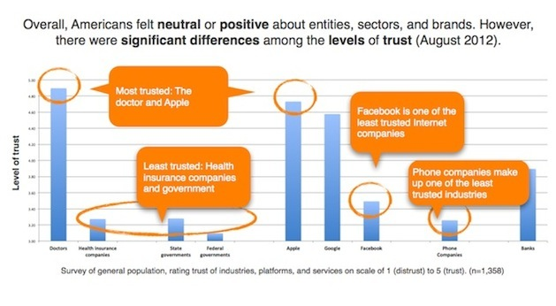
WHO DO YOU TRUST

Slide 11
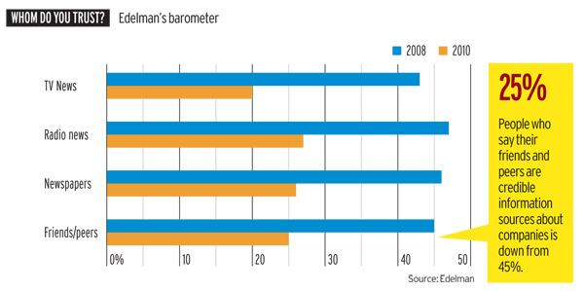
WHO DO YOU TRUST

Slide 12
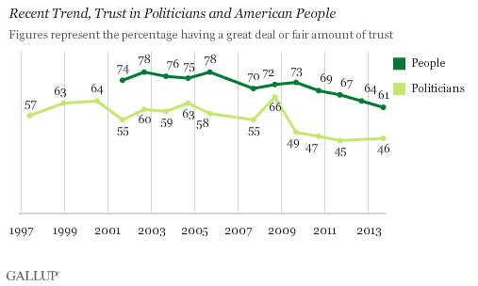
TRUST POLITICIANS AND PEOPLE

Slide 13
PHOTOS
LIBRARY OF CONGRESS 14 MILLION
FLICKR 8 BILLION
INSTAGRAM 15 BILLION
FACEBOOK 250 BILLION
380 BILLION IN 2012
880 BILLION IN 2014

Slide 14
BENJAMIN FRANKLIN STUDY
STANFORD PROFESSOR STUDIES FRANKLIN WITH THE FACEBOOK SYSTEM
LOOKING AT HIS SOCIAL NETWORKS AND WHO HE CORESPONDED WITH TO DETERMINE HIS INTEREST RATHER THAN READING HIS LETTERS!!!!!!!!
ONLY BECAUSE OF THE NEW COMPUTER TECHNOLOGY CAN THIS BE DONE
WHY????????

Slide 15
NO SOCIAL RELATIONSHIPS
NARCISSISM
Find out what child is doing by monitor their Facebook page
At work every 10 minutes check email to see if someone is thinking about you
Pictures of yourself to see how good you look
Attention spans fragmented into nanoseconds
Measuring social life by the number of Facebook friends

Slide 16
NARCISSISM cont.
Raising the generations of obsessive compulsive narcissists
Instant gratification
Self gratification
Intentional simplification of the complex and ambiguous
“Dumbing down”

Slide 17
Society is putting itself to sleep
Brave New World Farenheight 451 and 1984
Predicted universal individual deadening and increasing conformity
What is happening is rather universal individuality and deadening social involvement
We are all so individual that we are not part of a collective whole
Individual data nodes for each person that add up to big data

Slide 18
SOCIETY
Marketplace gratifies and reinforces the individual
There is nothing worse for a society than a culture where everyone feels that they can get what they want when they want it
Because of the loss of social cohesion there is a dissolution of civil society
That cohesion that makes it possible for democracies to function

Slide 19
SMARTPHONES RIP OUT OF SOCIETY
COGNITIVE LANDSCAPE
APPRECIATION AND NECESSITY OF
(1) AMBIGUITY
(2) UNPREDICTIBILITY
(3) RISK
(4) CONFLICT
(5) COMPROMISE

Slide 20
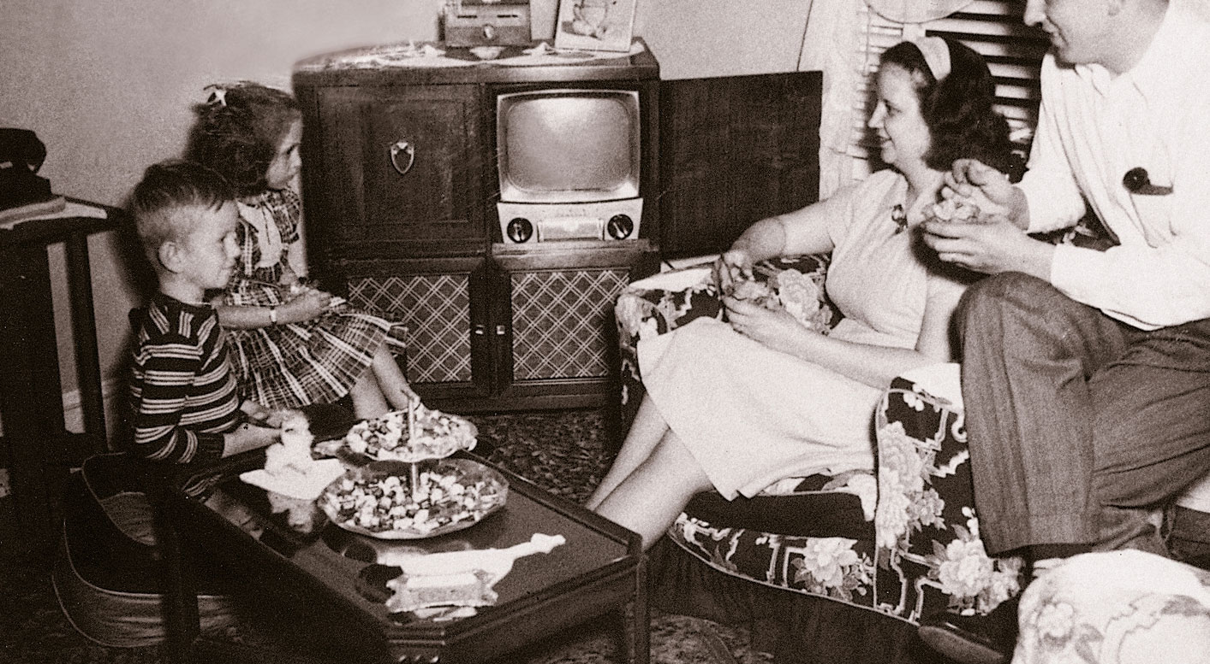
Early TV Community

Slide 21
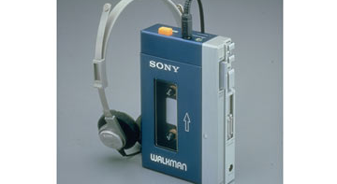
Walkman 1979

Slide 22
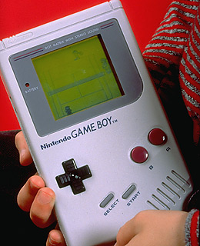
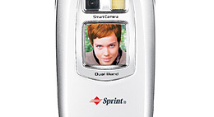
1989 Gameboy

Slide 23
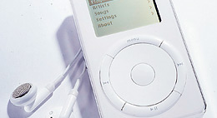
2001 IPOD

Slide 24
2002 CAMERA PHONE

Slide 25
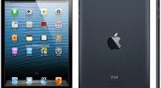
2009 Ipad

Slide 26
Paris perspective

Slide 27
Selfie Paris

Slide 28
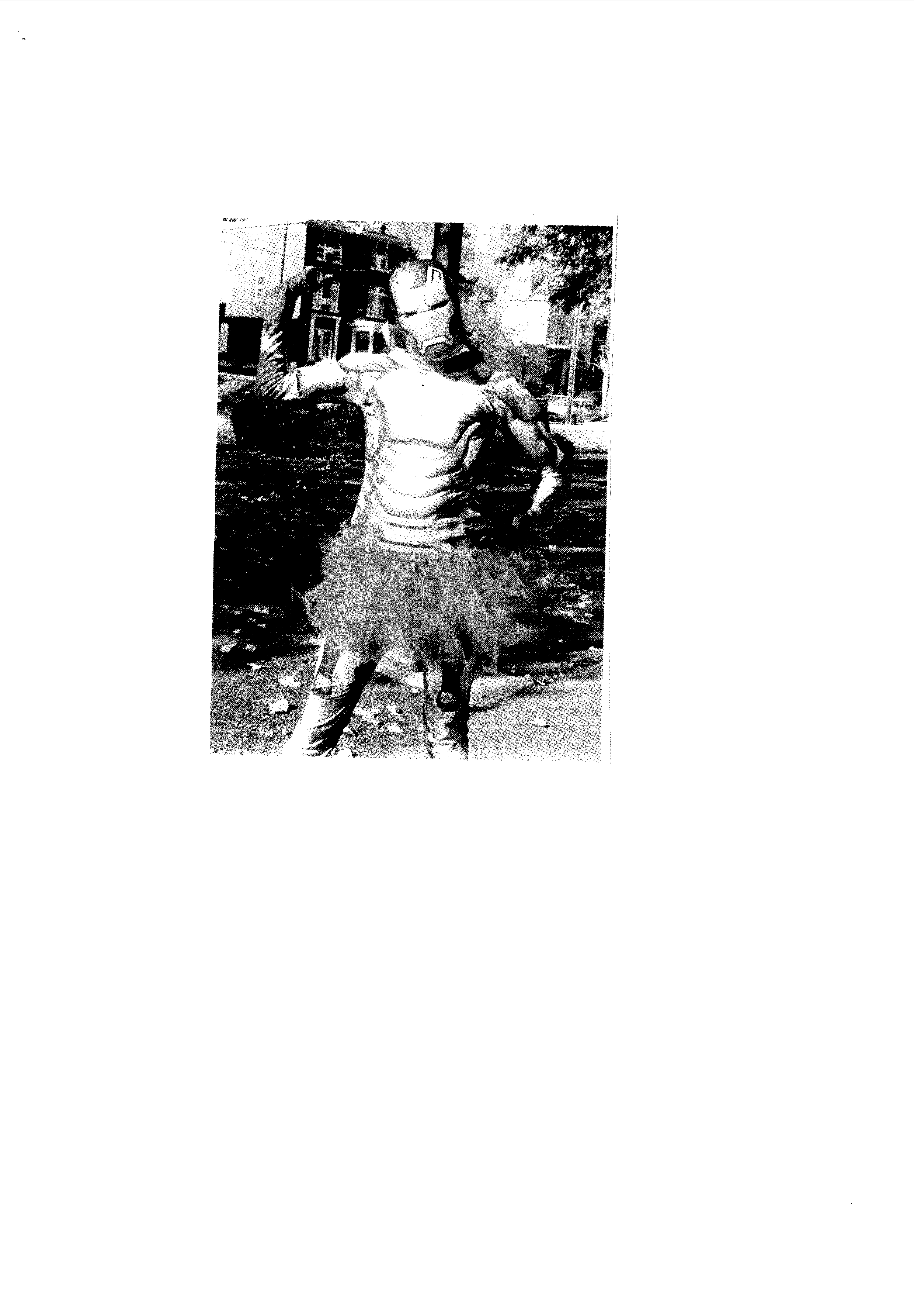
Iron Woman

Slide 29
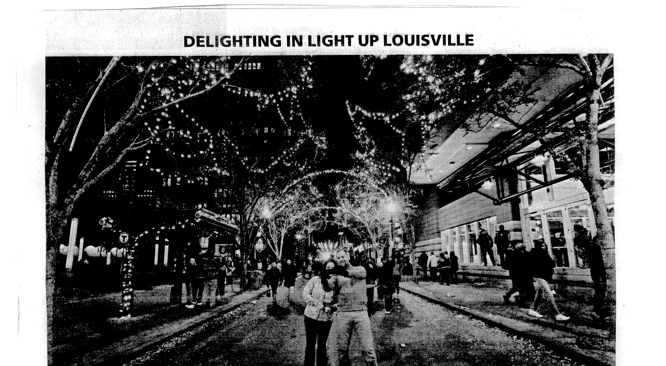
Louisville Selfie

Slide 30
Community not Narcissism as Democracy
The following slides are some ideas about how to promote community not only locally but globally as a means of promoting active engagement in society
The following shows some ideas about increasing community and decreasing individuality

Slide 31
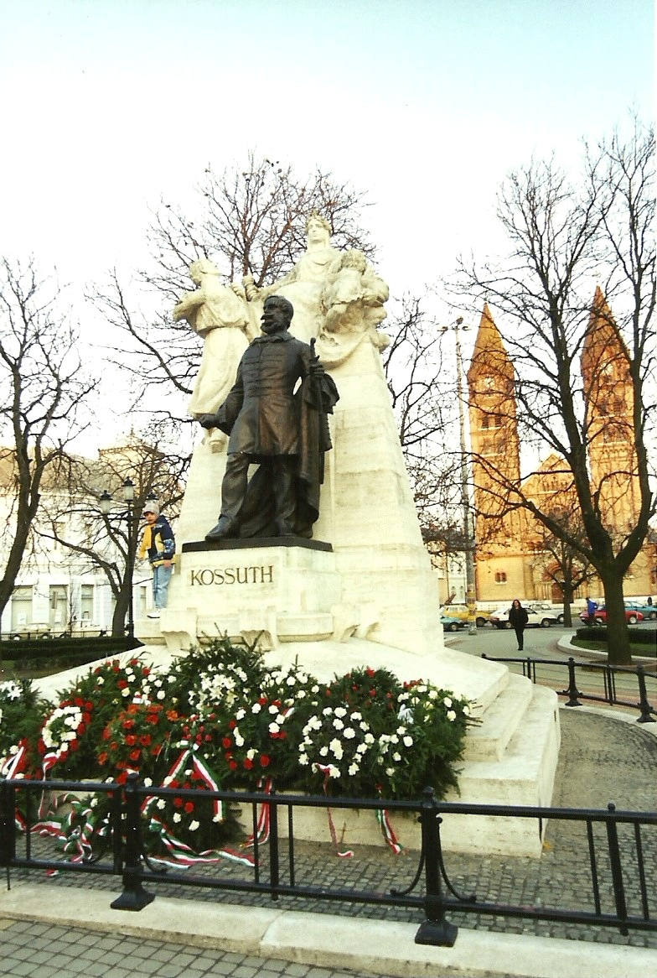
What is the role of freedom ?
Does a fight for freedom ensure democracy?
Whose freedom? After the fight for freedom for one group does that mean loss of freedom for another group? Is Egypt an example?

Slide 32
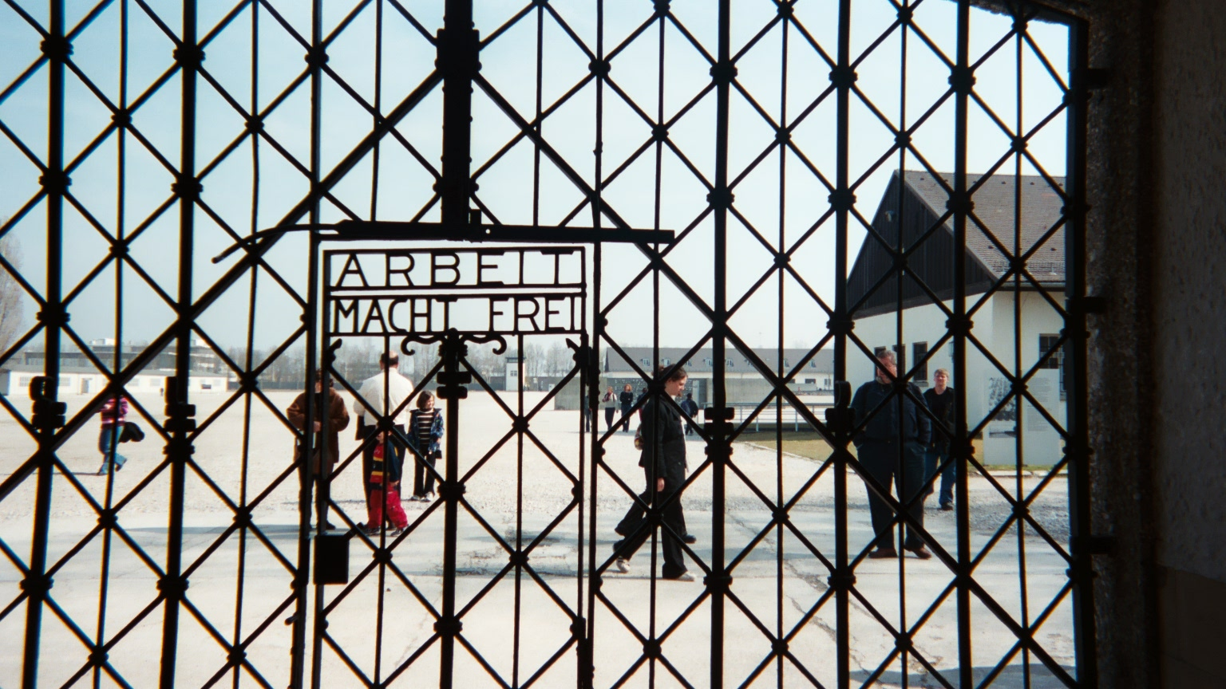
Is freedom a foundation of democracy no matter how it is defined?

Slide 33
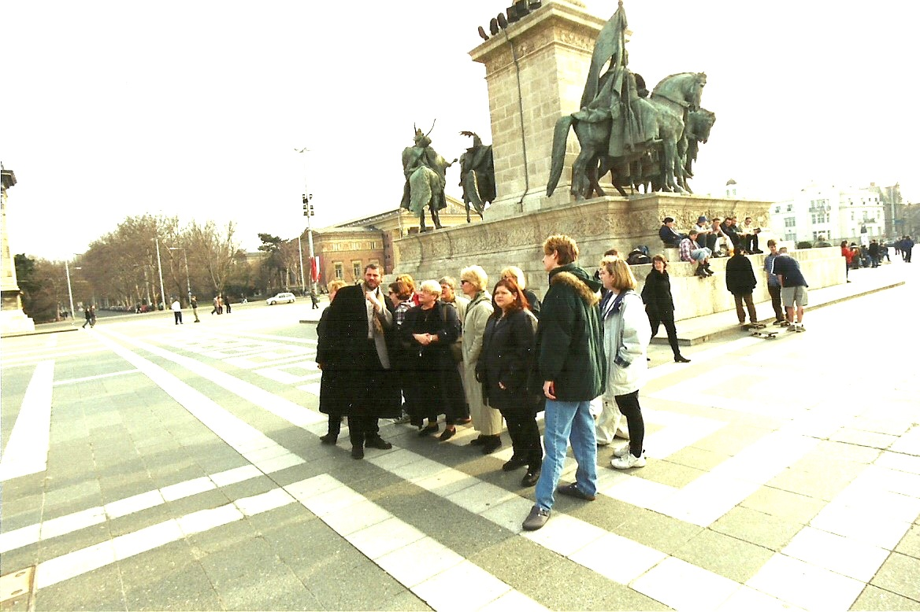
Democracy is about
understanding other cultures and their way of interpreting democracy

Slide 34
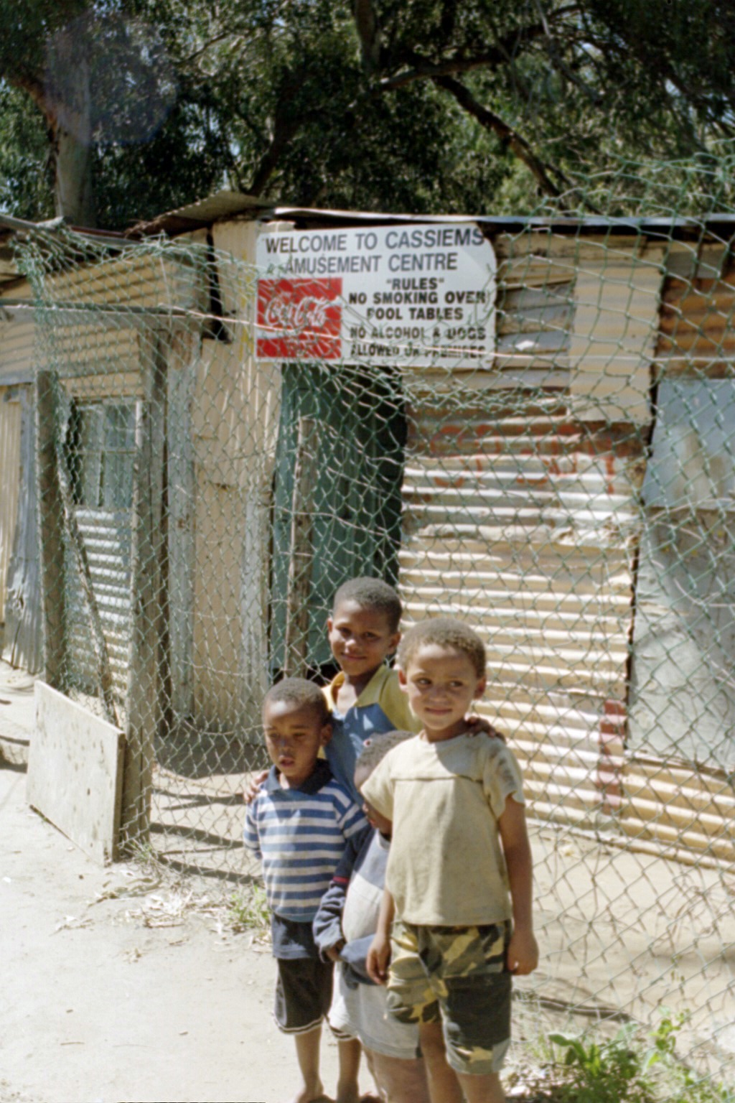
Democracy is acting in
ways that promote inclusion and sharing

Slide 35
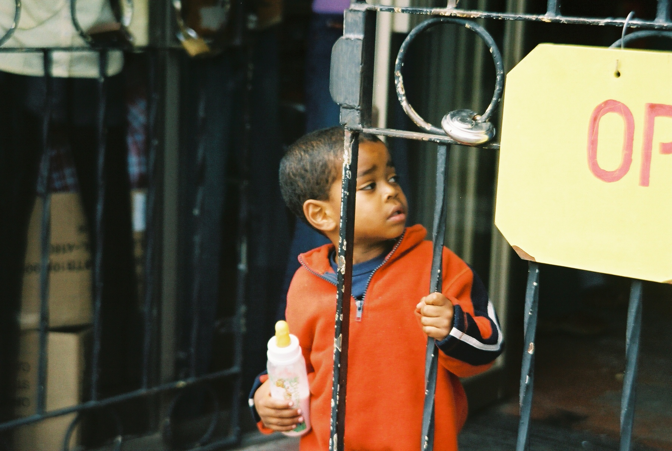
Democracy is not an intellectual pursuit – not a subject to be taught in a class. It is a living breathing thing that shows itself in one’s values and actions.

Slide 36
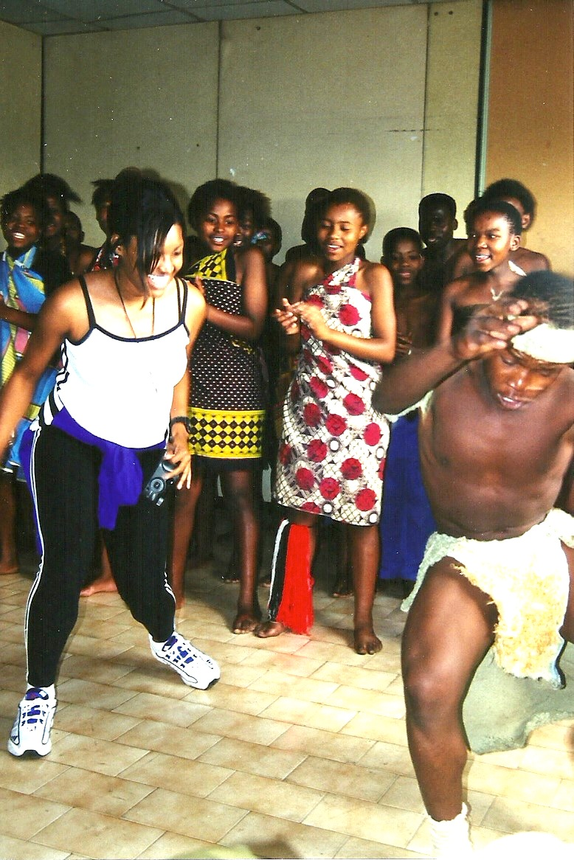
BALANCE:
Balance academic efforts between education for a job and education for understanding

Slide 37
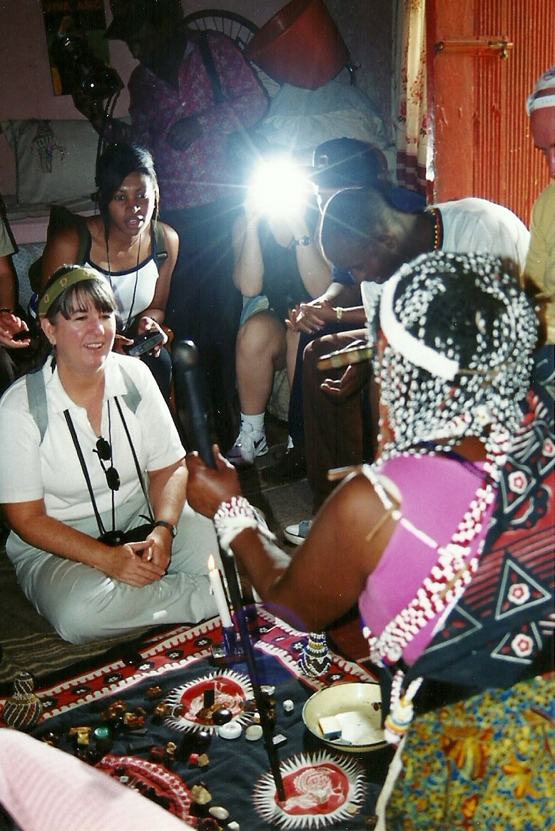
ACCEPTANCE:
Help people to accept others and their differences

Slide 38
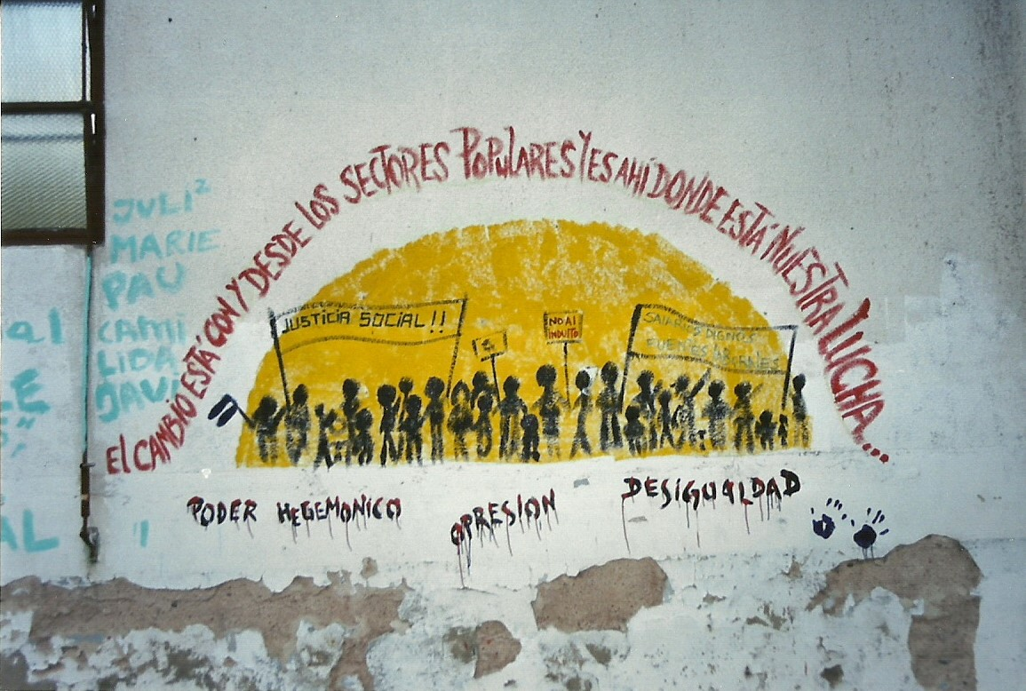
COMMITMENT:
to move young people toward a more humanistic and holistic understanding of the condition of all people

Slide 39
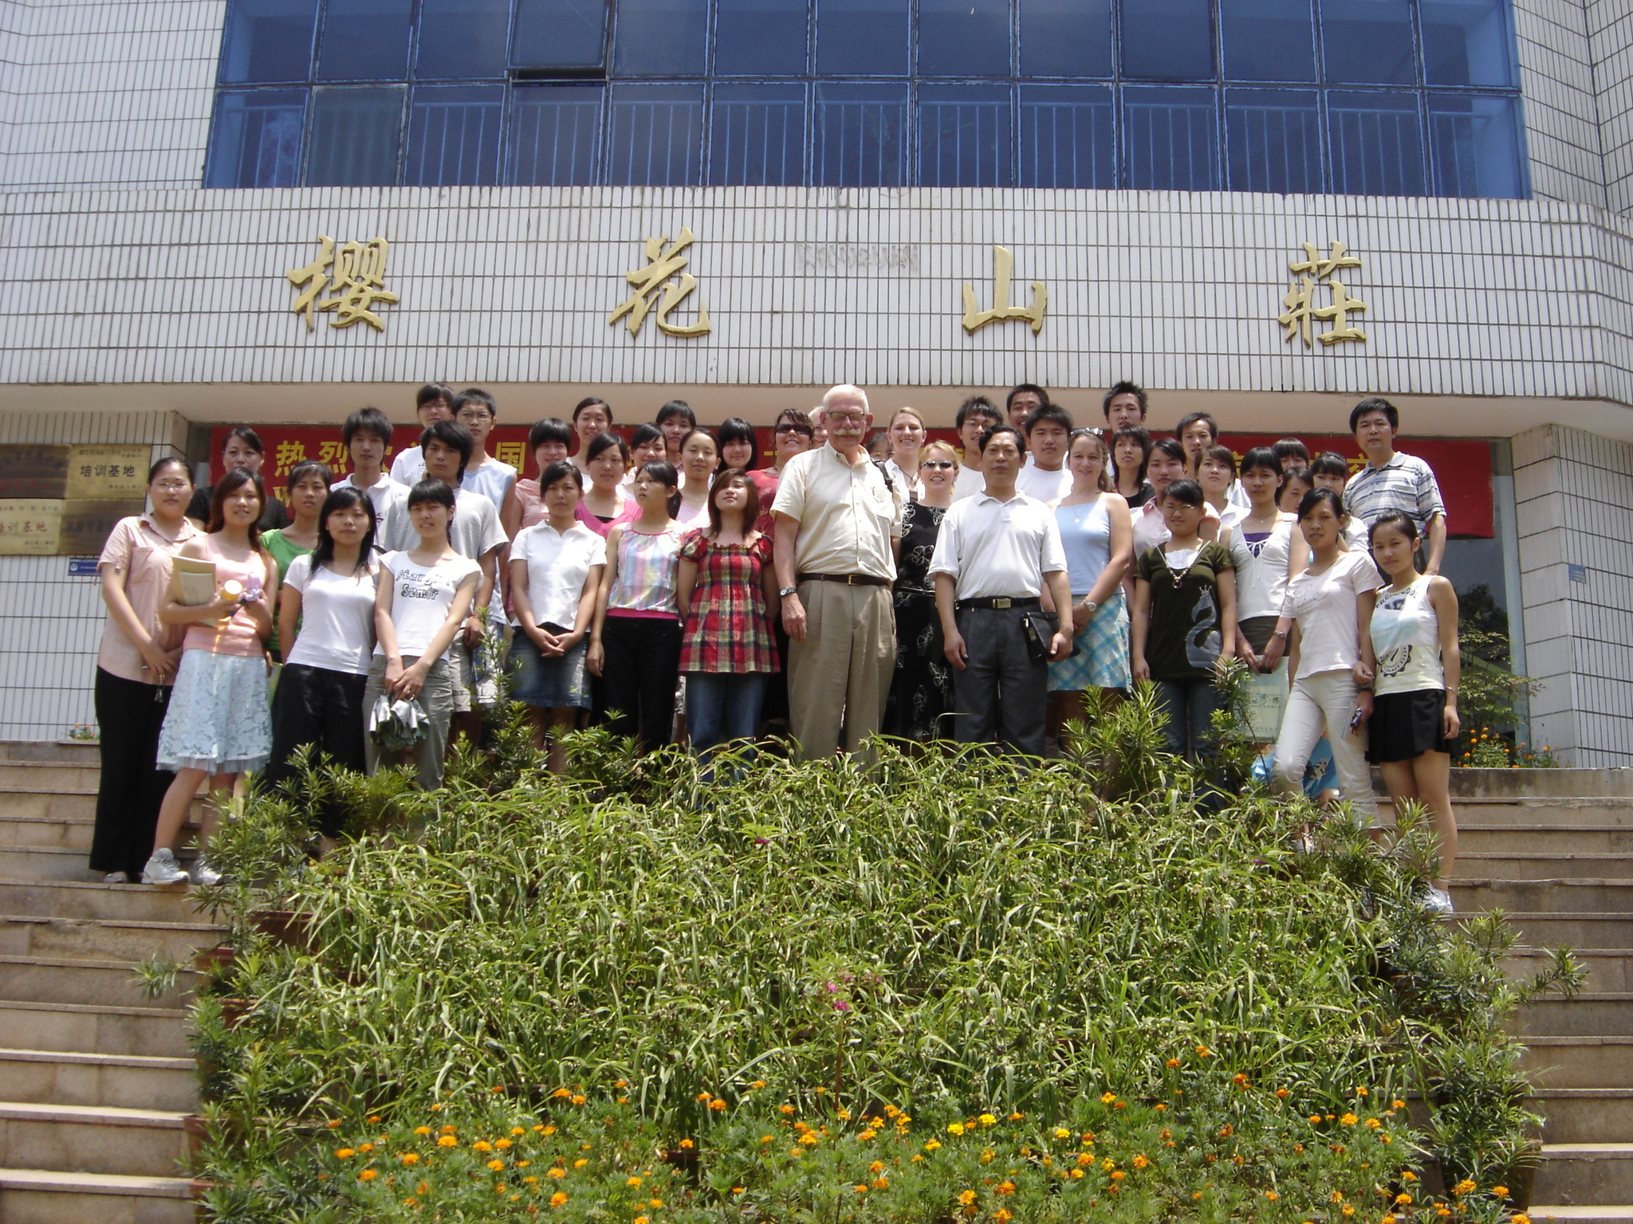
KNOWLEDGE:
Provide the requisite knowledge and skills to be able to interact with others on an equal basis

Slide 40
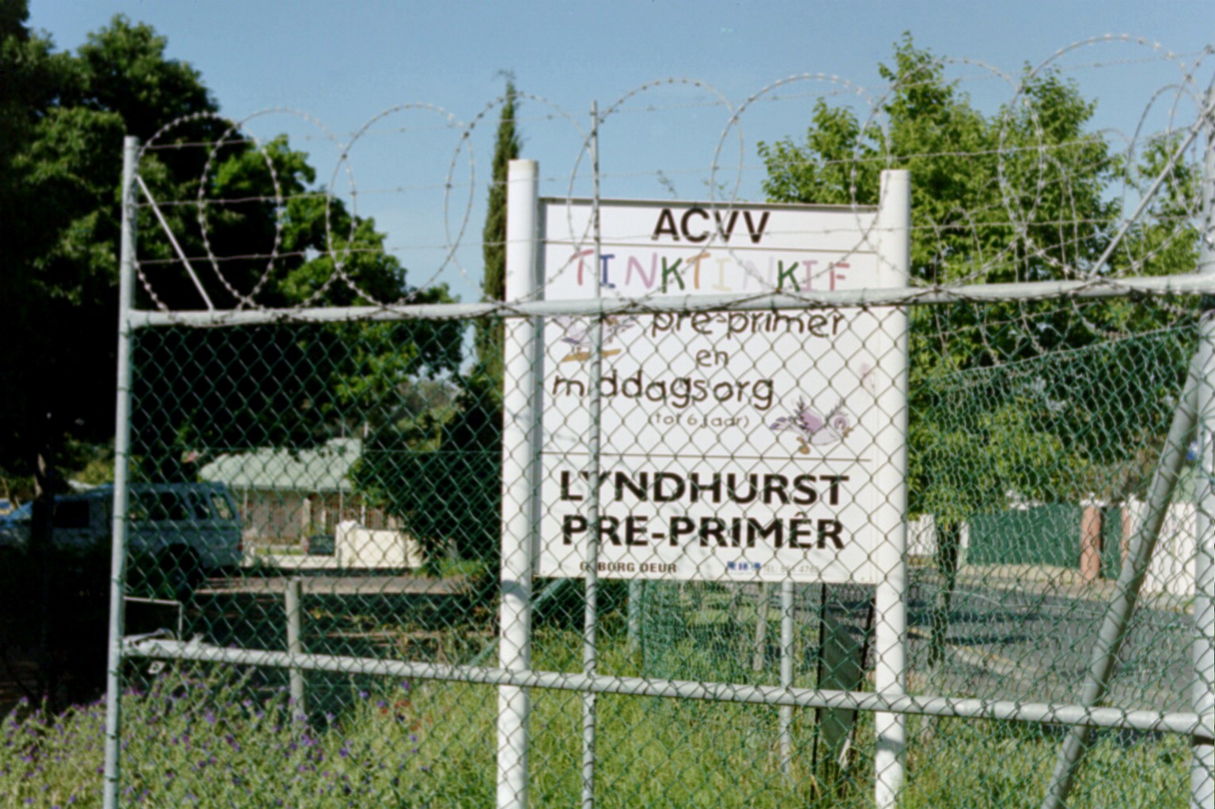
TIME:
Working with young people and others in this endeavor will take time and effort

Slide 41
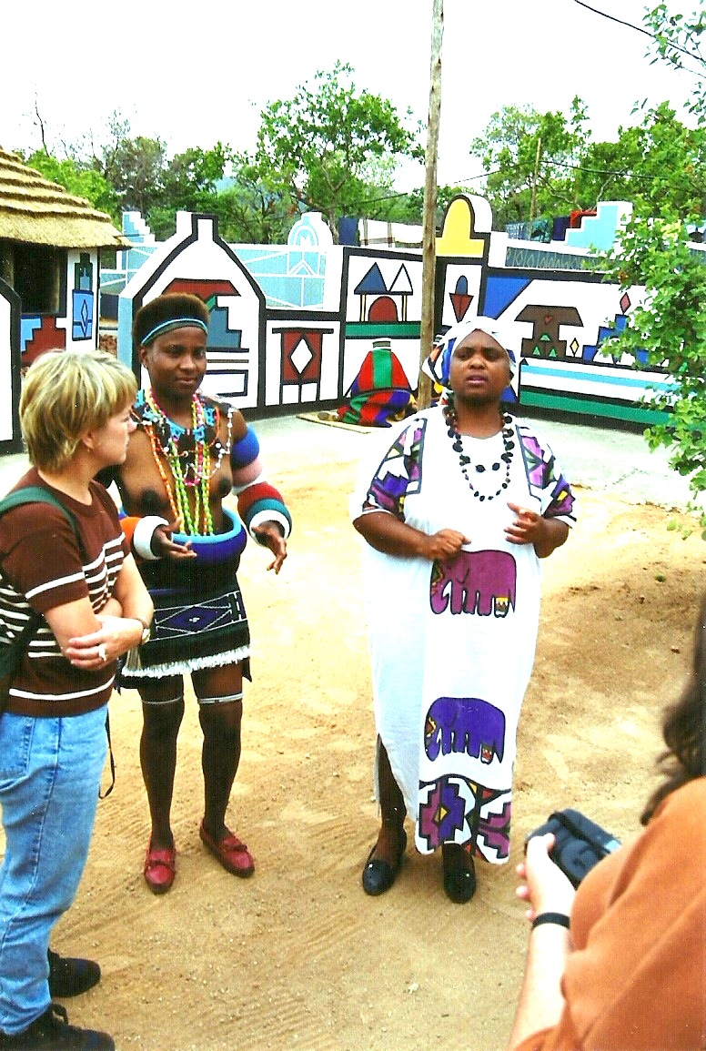
OBJECTIVE:
To help individuals to become objective in their perceptions of others

Slide 42
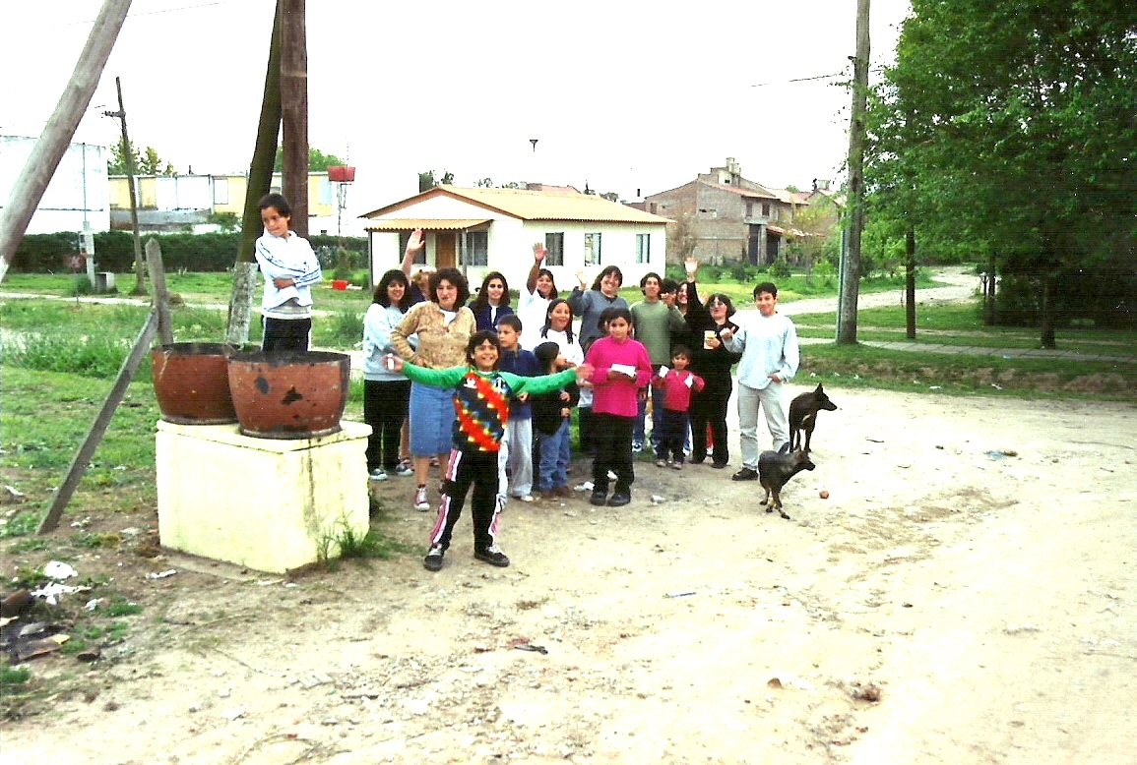
FOCUS:
Continually focus on the other person’s situation as the foundation of their life and our relationship with them

Slide 43
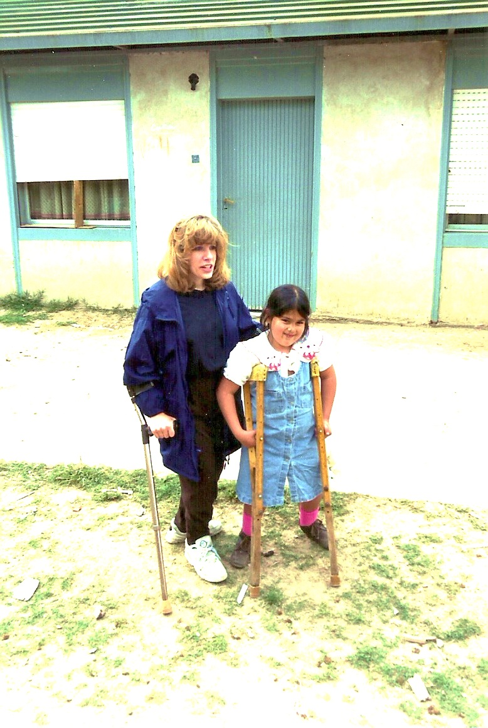
UNIVERSAL:
Recognize that human interaction is a universal phenomenon and one that transcends subject matter, institutions, culture and national boundaries

Slide 44
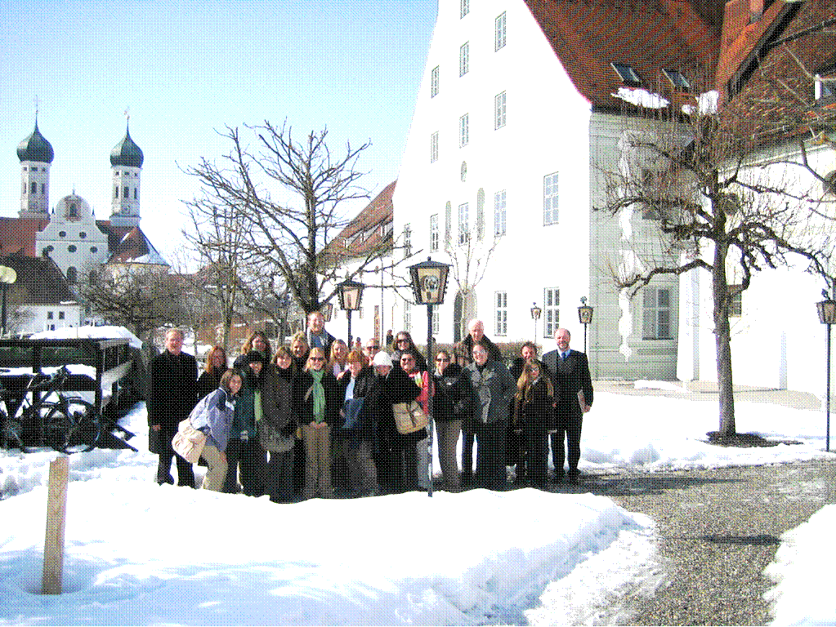
TOGETHER:
Understand that we must all be together in this effort

Slide 45
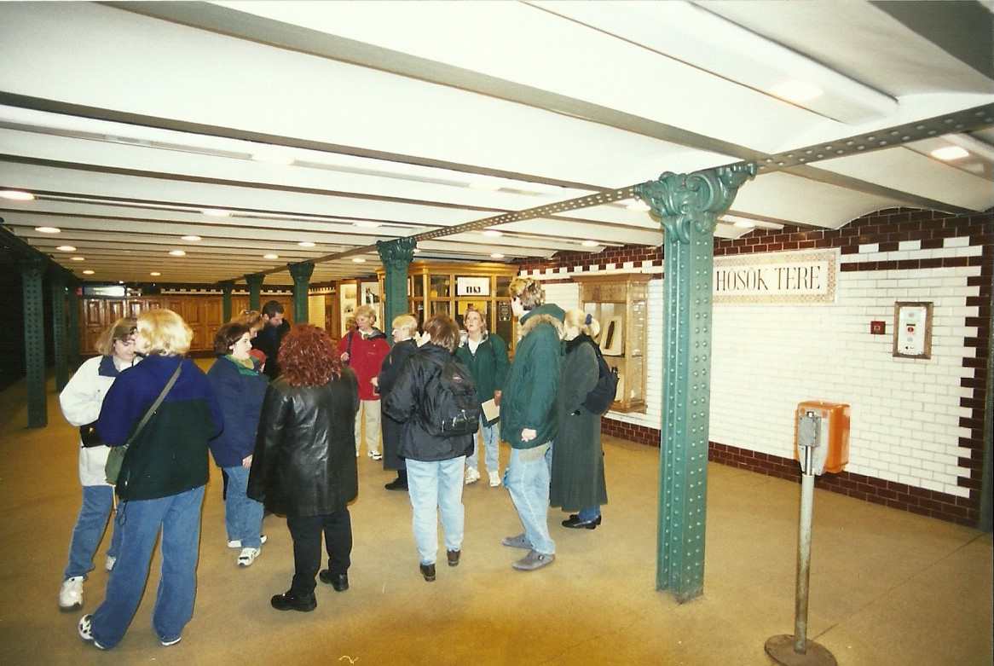
UNCERTAINTY:
Help to transcend the need for certainty in life and assist in seeing that uncertainty and differences make up the beauty of existence

Slide 46
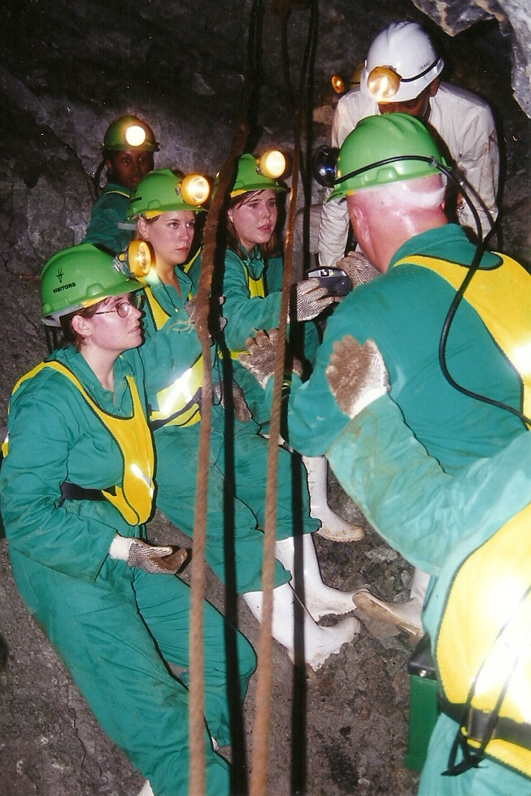
REALITY:
Demonstrate that reality is contextual and one must look at situations from many different perspectives and from another’s point of view in order to have a better understanding of the world we live in

Slide 47
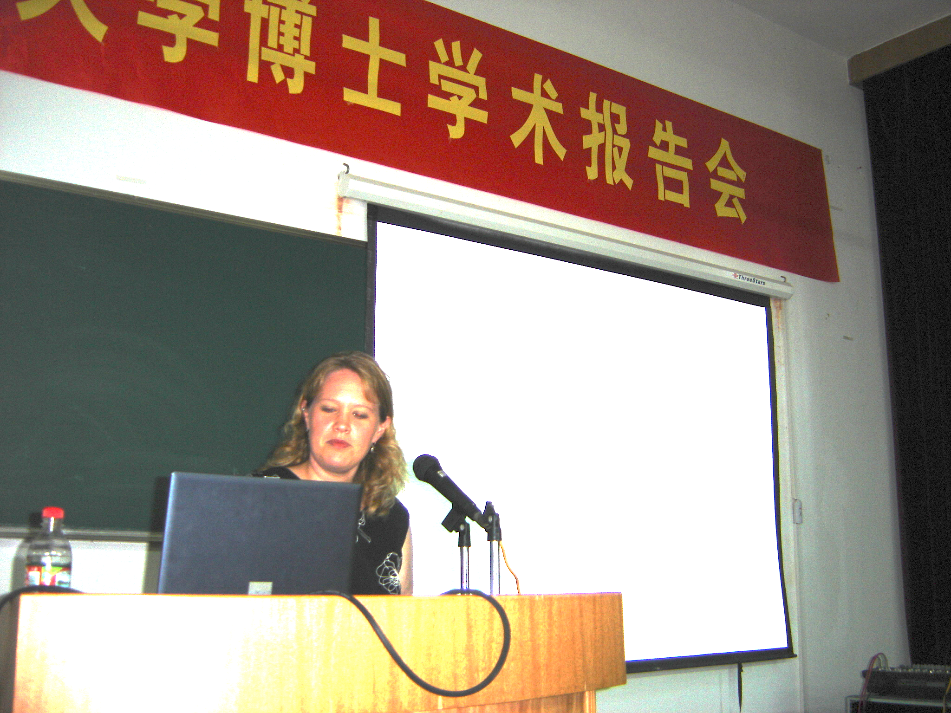
EDUCATION:
Use education as the tool with which to create global awareness and understanding

Slide 48
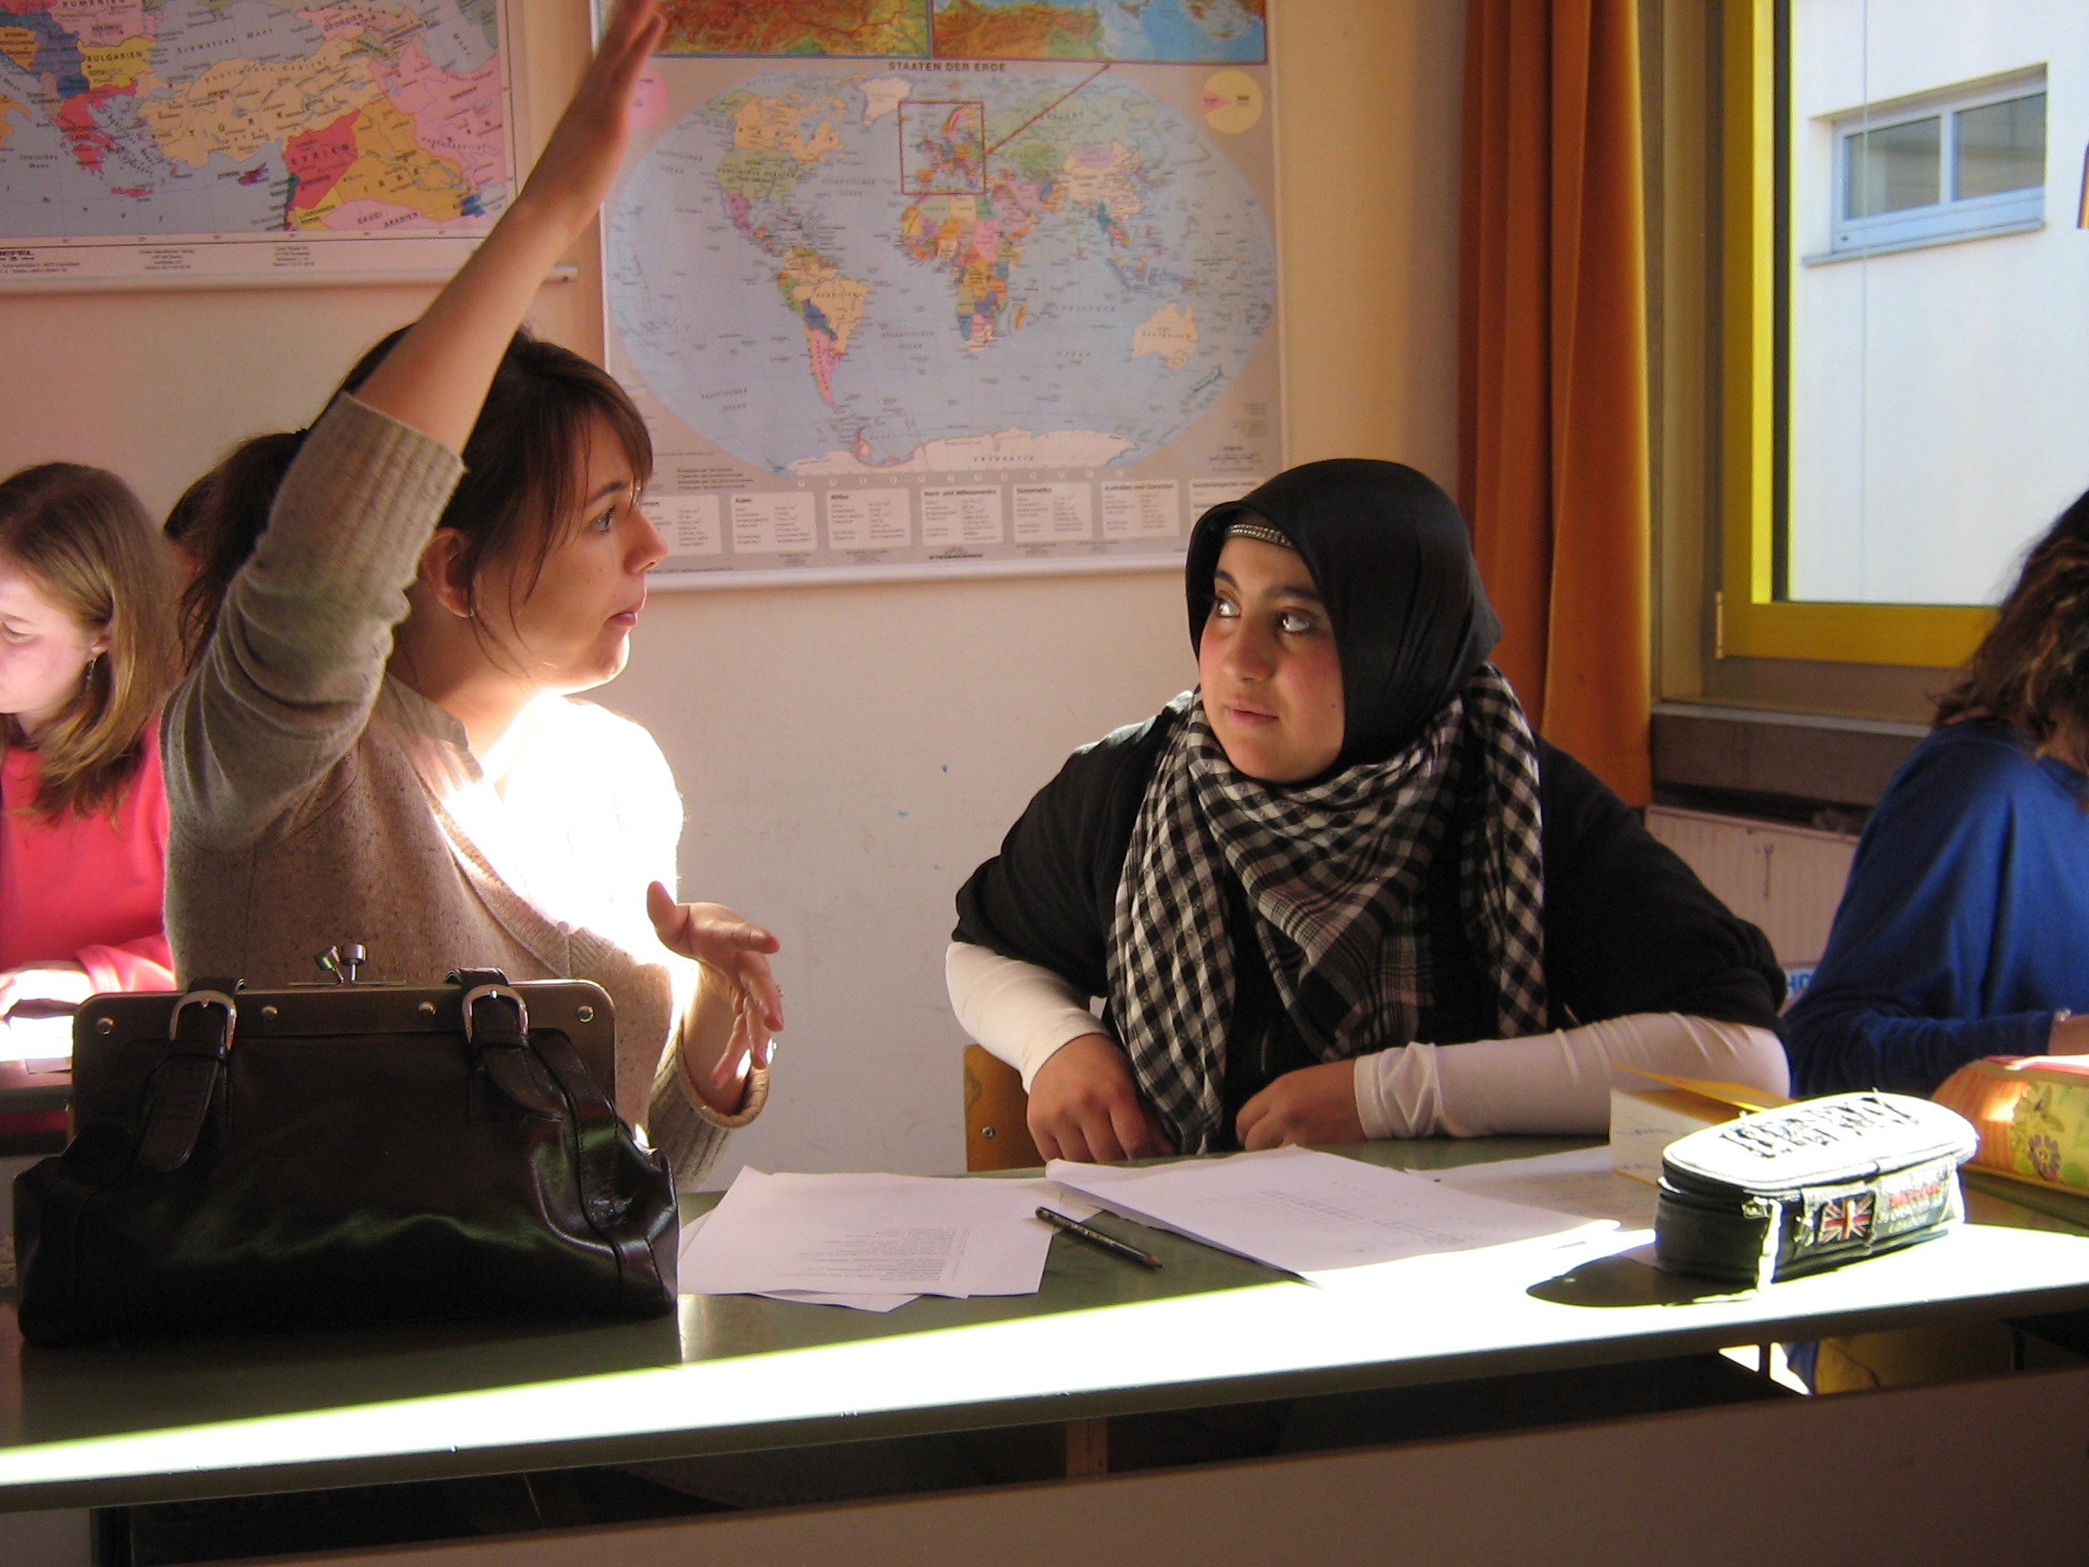
SSouth Africa
Community of Democracy

