Slide 1

A historical case - Investment of the human capital
The Hungarian cases
(a thought experiment)
15 november 2012
Debrecen
Ferenc Bódi Ph. D.
bodi@mtapti.hu
Centre for Social Sciences,
Hungarian Academy of Science
senior researcher fellow
Hungarian Scientific Research Fund (OTKA) 81667. Changes – Crises – Reactions (Adaptation of local organizations of social services in peripheral countries in Europe)

Slide 2
Crisis and Reaction and Change
Economic approach (Theory of Kondratiev’s waves,
Cycles impact on social mood and vice versa
Technological innovation theory
Period of Innovation - history of economic background - short review
Theory of social subsystems by Luhmann
A. Schultz: Investment in Human Capital
The Hungarian cases - reactions to crises - accumulation of human resources in the 18th and in the 19th century

Slide 3
Theoretical background I.
The First Column
Kondratiev Waves

Slide 4
Economic approach (Theory of Kondratiev’s waves,
The Russian economist Nikolai Kondratiev was the first to bring these observations to international attention in his book The Major Economic Cycles (1925) alongside other works written in the same decade.
His conclusions were seen as a criticism of Stalin’s intentions for the Soviet economy: as a result he was sentenced to the Soviet Gulag and later received the death penalty in 1938. Later, in Business Cycles (1939), Joseph Schumpeter suggested naming the cycles "Kondratieff waves", in honor of the economist who first noticed them.
Today 2008’s financial crisis has increased an interest in the theories of long economic cycles (including Kondriatiev cycle) as a potential explanation of its cause.

Slide 5
Cycles impact on social mood and vice versa
Technological innovation theory
Spring stage: social shift in wealth, capital accumulation, and innovation
Summer stage: Stagflation(rising inflation, rising unemployment, etc.)
Fall stage: deflationary growth (budget austerity)
Winter stage: depression, integration of previous social shift and change into social stratification

Slide 6
Period of Innovation - history of economic background - short review
According to Mensch, Gerhard (1979). Stalemate in Technology: Innovations Overcome the Depression.
The Industrial Revolution—1771
The Age of Steam and Railways—1829
The Age of Steel and Heavy Engineering—1875
The Age of Oil, Electricity, the Automobile and Mass Production—1908
The Age of Information and Telecommunications—1971

Slide 7
First industrial revolution 1780-1840’s
Innovation
Saturation point
Cotton-based technology: spinning weaving; atmospheric stationary steam engines … wrought iron, iron displaces wood in machinery, canals…
Cotton textiles: British market saturated ca. 1800. By 1840, 71% of British cotton textiles were exported…

Slide 8
Railroad and Steam Engine Era 1840-1880’s
Innovation
Saturation point
Age of steam railways, steam shipping and machinery, animal powered combine harvesters, etc. Emergence of petroleum and chemical industries…Beginning of public water and sewer systems. Telegram.
Late 1840s Canals
1870: Steam exceeds water power and animal power.
1890s: Railroads.

Slide 9
Age of steel, electricity and internal combustion 1880-1930’s
Innovation
Saturation point
Steel, electric motors, electrification of factories and households, electric utilities, aluminum, chemicals and petrochemicals, internal combustion engine, automobiles, highway system, Fordism mass production, telephony, beginning of motorized agricultural mechanization, radio. Electric street railways help create streetcar suburbs. Build out of urban public water supply…
Post WW I short depression. Railroads and electric street railways decline. After 1923 industrial output rises as workforce slowly declines. Depression of 1930s: Overcapacity in manufacturing, real estate. Work week reduced from 50 to 40 hours in mid-1930s. Total debt reaches 260% of GDP during early 1930s.

Slide 10
WAR and Postwar Boom 1930-1980’s
Innovation
Saturation point
Oil displaces coal. Suburban growth and infrastructure. Greatest period of agricultural productivity growth 1940s-1970s. Consumer goods, semiconductors, business computers, plastics, synthetic fibers, fertilizers, television and electronics, green revolution, military-industrial complex, diffusion of commercial aviation and air conditioning, beginning nuclear utilities.
1940s-50s: Diesel locomotive displaces steam. 1971: Peak U.S. oil production 1973: Peak steel consumption in U.S. Pennsylvania steel cities and industrial mid-west turn into "rust belt". 1973: Slow economic and productivity growth noted. 1980s: Highway system near saturation…

Slide 11
Post Industrial Era: Information Technology and care of elderly 1980-?
Innovation
Saturation point
Fiber optics and Internet, personal computers, wireless technology, on line commerce, biotechnology, Reagan's "Star Wars" military projects. Energy conservation. Beginning of industrial robots. In the U.S. health care becomes a major sector of the economy (16%) and financial sector increases to 7.5% of economy.
1984: Peak U.S. employment in computer manufacturing. Long term decline in U.S. capacity utilization
1990s: Automobiles, land line telephones, chemicals, plastics, appliances, paper, other basic materials, commercial aviation.
2001: Computers, fiber optics 2000s: Crop yields approach limits of photosynthesis. 2008: Developed world on verge of depression etc.

Slide 12
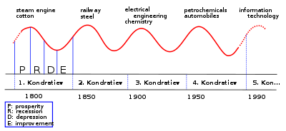
Sequence of technological Kondratiev Waves

Slide 13
Theoretical background II.
The second column Investment in Human Capital

Slide 14
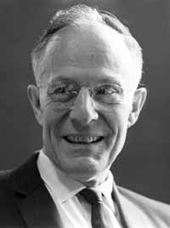
A. Schultz: Investment in Human Capital
1971. Investment in Human Capital: The Role of Education and of Research, New York: Free Press.
1972. Human Resources (Human Capital: Policy Issues and Research Opportunities), New York: National Bureau of Economic Research,
1981. Investing in People, University of California Press. Description and chapter-preview links.
1993. The Economics of Being Poor, Cambridge, Massachusetts, Blackwell Publishers

Slide 15

Human Capital Theory
Schultz researched into why post-World War II Germany and Japan recovered, at almost miraculous speeds from the widespread devastation. Contrast this with the United Kingdom which was still rationing food long after the war. His conclusion was that the speed of recovery was due to a healthy and highly educated population; education makes people productive and good healthcare keeps the education investment around and able to produce. One of his main contributions was later called Human Capital Theory

Slide 16
Theoretical background III.
A sociological Theory of Law

Slide 17
Theory of the social subsystem by Luhmann
(A Sociological Theory of Law, London: Routledge, 1985)
Political
4-5 years
Economy
7-11 years
Legal System 20-30 years

Slide 18
Crisis and Reaction - accumulation of human resources period in the 18th in Hungary
Reconstruction – Resettlement
4000 schools 1770
Prosperity of Wheat 1790-1815
Sons of the crisis – Reform Age
1834-1848
Marothi’s Reform Debrecen College 1738
The Piaris appeared 1721
Peace Treaty 1711
The end of the Napoleon War
Great Plague 1708

Slide 19
it was used the Kosáry's studies especially his Hungarian of Schools History
Kosáry: Művelődés a XVIII. századi Magyarországon Akadémiai Kiadó, Bp., 1996.
Kosáry: Újjáépítés és polgárosodás, 1711-1867 Háttér Kiadó, Bp., 1990.
External links
The Guardian: Domokos Kosáry, The pre-eminent Hungarian historian of the 20th century
The Hungarian cases - reactions to crises - accumulation of human resources in the 18th and in the 19th century

Slide 20
Lutheran Seminars 18th century
Lutheran Seminars had a main aim to provide education for broad secular classes. Pedagogical principles were the pietismus (Francke pedagogy school).
Parts of the curriculum: Geography, Modern language (French, German), mother tongues (Hungary, German, Slovakian) Latin, History, Geometry, Botany, Polytechnic, Experimental Physics, Natural Sciences, Reading Newspapers.
Despite of Jesuit pressure 35 Lutheran schools were able to survive the difficulties of the century.
22 small high-schools
8 high-schools
5 (academy) high-schools: Pozsony, Sopron, Késmárk, Lőcse, Eperjes.

Slide 21
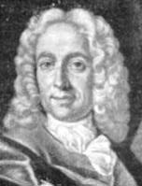
Mátyás Bél Rector
Pozsony Lutheran Academy high-school had 500 students, especially citizen’s children (urban middle class) and Highland (Felvidék) noble-born children.
Poor children were able to appear in the Lutheran schools, Thanks to Bél Mátyás Rector who introduced the school registers and support for orphans and poor students.

Slide 22
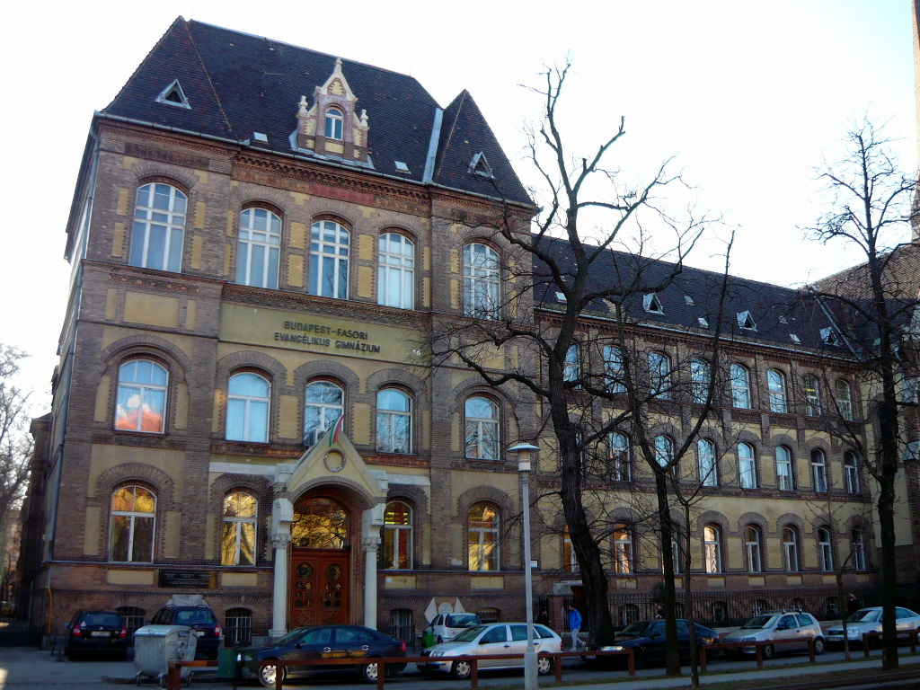
Evangélikus Fasori Gimnázium Budapest
Formers students of Budapest Lutheran High Schools (Fasori Gimnázium) were János Harsányi economist he was a co-recipient along with John Nash and Reinhard Selten of the 1994 Nobel Prize in Economics. Formers student was János Neuman, who has developed the computer in USA. Formers student was Jenő Wigner who had got Nobel Prize in Physics in 1963.

Slide 23
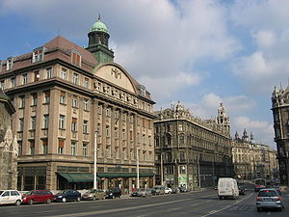
The Piarist
At the beginning of the period the Piarists had 3 schools in Hungary, at the end of the period this number reached 21.
The Piarist’s schools taught free from feudal restraint. Their curriculum was modern and opened to science:
Physics of Newton, Wolff, Galileo…,
Mathematic of Descartes and Leibniz,
Land surveying,
Descriptive statistics,
These modern sciences overshadowed the Scholasticism - maintaining the hegemony of classical languages as Ancient Greek and Latin.
Piarista Gimnázium Budapest

Slide 24
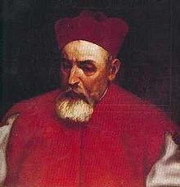
The Jesuits
At the beginning of the 18th century the Jesuits had 26 Latin schools and 19 high-schools. Péter Pázmány established the University of Nagyszombat – “studium generale”. This university moved to Pécs (University of Pécs) in the 20th century after the first WW.
Their specialty was jurisprudence / education of lawyers.
Péter Pázmány

Slide 25
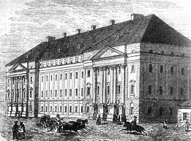
The Calvinist Colleges
The Calvinist church schools continued Puritan, Cartesian their traditions.
The Calvinist schools were less controllable by the royal court in the eastern side of the Country
This Calvinist school system achieved strong effect on the Great Plain and the Transylvanian regions.
Main school centers: Debrecen (1400 students), Sárospatak (1200 students)
Kolozsvár, Marosvásárhely, Nagyenyed.
For example 21 high-schools (Latin schools) belonged to Debrecen College in the 18th century.
Debrecen Calvinist College

Slide 26
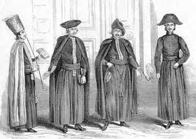
Students of the Debrecen Calvinist College in 18th century
The teacher of the college recruited senior students who often were able to teach junior students. Autonomous school-board checked the curriculum affairs and disciplinary matters.

Slide 27
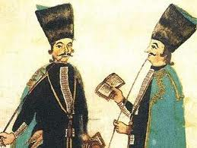
Students of the Debrecen Calvinist College in the 18th century
There were no scholarships for poor students but the college allowed them to work instead of paying tuition fees. These students who did not pay for the education were the so-called “servant students”.

Slide 28
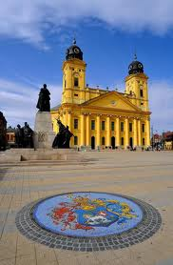
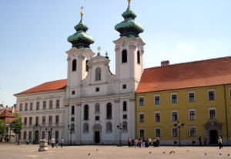
The Calvinist and The Jesuits
The Calvinist church college curriculum did not differ essentially from the Jesuit curriculum as both schools taught modern Sciences (Physics, Mathematics, Geographic, etc.) The language of the education was the Latin in the both schools in the 18th century. Don't forget that the Latin language was the language of the public administration as well as the official language throughout the Kingdom of Hungary till 1846.
Nevertheless there was an important difference; the Calvinist College was controlled by local leaders (presbyter system) however the Jesuit academy was controlled by a central leader (governor of the province).
While the Jesuits received significant supports and donations from the Royal Court Calvinist schools had got support from England and the Netherlands and Switzerland.

Slide 29
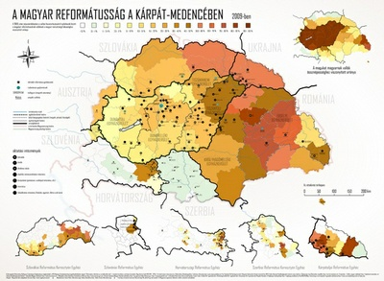
Calvinist Church in the Carpathian basin
Beyond the foreign support the college had several own significant funds for education. These funds were able to give credit; essentially the Debrecen College became the main credit institution in the Great Plain in the end of the 18th century.

Slide 30
Crisis and Reaction - accumulation of human resources period and Reform age
Reconstruction – Resettlement – Economic and Constitutional crisis
4000 schools 1770
Prosperity of Wheat 1790-1815
Sons of the crisis – Reform Age
1834-1848
Marothi’s Reform Debrecen College 1738
1848-1849 Revoution and Independent War
The Piarist appeared 1721
Kölcsey (1823): Hymn
Peace Treaty 1711
The end of the Napoleonic War
Bölöni (1834): Journey in North America
Great Plague 1708

Slide 31
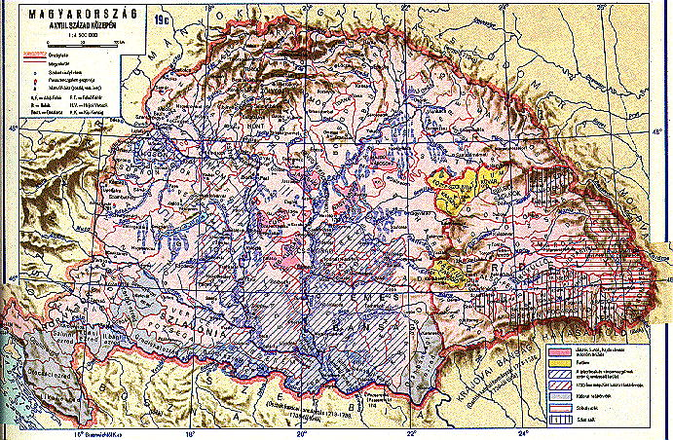
Accumulation of Human Resources (cause and results)
There was an essential human source accumulation phase in the cycle between two crises in Hungary during the 18th century, from 1708 to 1815. This investment in human sources was an expansion which culminated at the end of this century. The stagnation of the reconstruction phase was at the beginning of the 19th century. This saturation point coincided with the world economic saturation point which coincided with the end of the Napoleon War. Why?

Slide 32
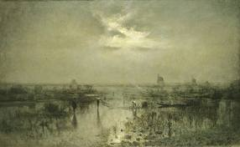
„There is no life outside of Hungary!” –
„Extra Hungariam non est vita!” ☺
Hungary was able to catch up with the periphery of Europe. This way, the Hungarians were able to climb up the last coach… But their economic system was not modern and did not have ability to change because the feudal political regime did not allow radical changes in the social system as well as in the economic base and last but not least to do reform in the feudal state itself.
The prosperity of Napoleon War could reserve temporary a feeling of a kind of welfare among the rural landlords. The “wheat prosperity” hid several economic and social problems. The productivity was too low in the agriculture and there was no road and canal for the transportation of goods. The land was covered by water when the rivers flooded in Great Plains. Then quarter of the country was under water.

Slide 33
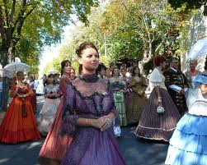
The new generation appeared in the stage
The ancient law system was getting in the way of the progression. After the Napoleon War the food exports (cattle and wheat as well as wine, etc.) reduced, the income of the landlords reduced, too. The crisis expanded through the whole country. But by then, a new generation had grown up which could not see and did not want to see the world like their father did. By then, a new generation had appeared in the country which could travel overseas and could bring new experiences about the whole world.

Slide 34
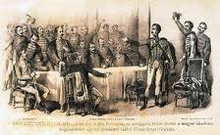
Approximately 30,000 high educated person lived in the Hungary in beginning of the 19th century (Kosáry Domokos)
This new generation entered into the politics and entered military career, too. And last but not least young officers appeared in the public administration, especially in the local and county level. They were Catholic, Lutheran, Calvinist, Unitarian, respectively. They came from ancient families or incomer citizen families as well as merchant families. One thing was in common in them: they all were well-educated.

Slide 35
Reform age
Sons of the Crisis
1831-1848

Slide 36
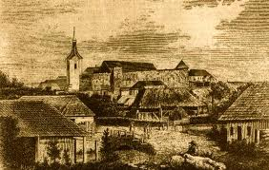
Bölöni Farkas Sándor
Sándor Bölöni Farkas (Alexander Farkas Bölöni) was born in 1795 in Bölön in Transylvania. His schools: beginning in 1805 in the Unitarian College, he went on at the Royal College, both in Kolozsvár, faculty the jurisprudence / he graduated as an educated lawyer in 1815. He became a young clerk in Kolozsvár in Transylvania (now Cluj Napoca in Romania). He established The “Gondviselő Társaság” (Society of Providency) a credit unions which had existed until 1944. He translated Schelling, Goethe and other German romantics. Women’s Reading Club was created by his initiative. The first people’s paper (magazine) was published in 1834 which was founded by him.

Slide 37

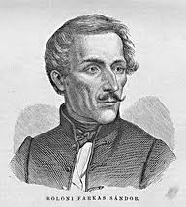
He was a writer who is perhaps best known for his work (Journey in North America) he made while traveling in the United States in 1831. He described the United States as a wonderland, and praised American democracy very high. The book was banned by the Catholic Church in 1834. His diary contained already the New Hampshire Constitution, the Declaration of Independence before other source would publish in Hungary. According to some Hungarian historians this book opened the Reform Age in Hungary.
This diary was a detonator, because this book published statistical description (exact data about the Census of the U.S. in 1830), it published an exact state description about the U.S., highlighted the idea of ​​independence, equality and freedom.

Slide 38
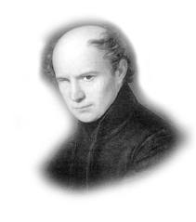
Ferenc Kölcsey
Kölcsey was born in Sződemeter, Hungary (now Săuca, Romania). He was orphaned at an early age and handicapped by the loss of an eye due to smallpox.
He attended the Debrecen Calvinist College from 1796 to 1809. He learnt all available subject, he learnt with devotion the Greek mythology and history as well as ancient Greek literature. It was in 1813 he learnt poetry first. He studied mainly Latin poetry, later his interest turned to the French and German literature, especially he was interested in the age of the King Louis XIV.
At the age of fifteen, he made the acquaintance with Ferenc Kazinczy and adopted his linguistic reforms. In 1809 Kölcsey went to Pest and became a notary to the Royal Board. He was disappointed of the office and, while staying at Cseke in Szatmár county, he devoted all his time to aesthetical studies, poetry, criticism, and the defense of Kazinczy's theories.

Slide 39
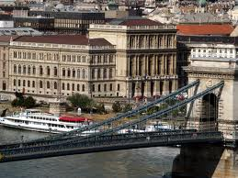
Pozsony; Hungarian Diet and Pest: Hungarian Academy of Sciences
From 1832 to 1835 he sat in the Hungarian Diet (nowadays the Parliament), where his extreme liberal views and his eloquence rendered him soon famous as a parliamentary leader. Elected in November 1830 as member of the Hungarian Academy of Sciences, he took part in its first grand meeting in 1832, he held his famous oration in favor of Kazinczy, and in 1836 against his former opponent Dániel Berzsenyi.

Slide 40
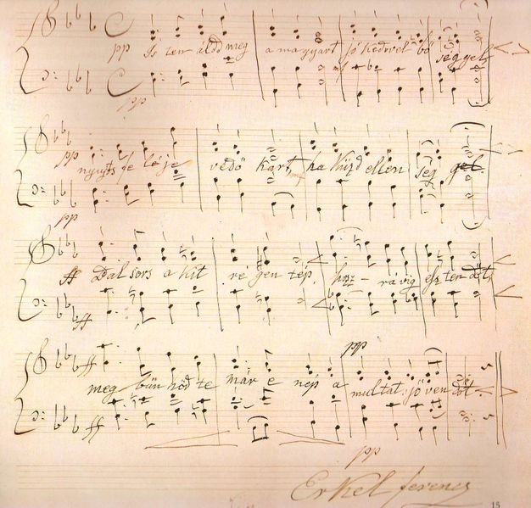
Ferenc Kölcsey: Himnusz Anthem of Hungary
His most famous poem is Himnusz – “Hymn” (1823), evoking the glory of Hungary's past, became the national anthem of Hungary. It was adopted in 1844 and its first stanza is sung at official ceremonies. Its currently official musical setting was composed by the romantic composer Ferenc Erkel.

Slide 41
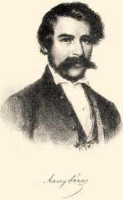
János Arany
He was born as the tenth child in a fortuneless family In Nagyszalonta in 1817. His parents were simple farmers. Because he wanted to help his elder parent’s financial position he taught while he learnt and he lived in the school.
From 1833 he attended the College of Debrecen but as his hope had not realized and his money was not enough, in 1839 he went to Kisújszállás to teach as a temporary teacher to earn some money to continue his studies. In Kisújszállás Pál Török was the Rector (later bishop of Calvinist) who opened the famous library for Arany, who was reading non-stop. One year later he went back to the Debrecen College, where his teachers also noticed him.
He became the top of the class with the Lector’s letter of recommendation and his diligence. Because he regularly taught, his financial situation had become even tolerable (there were some illustrious persons among his private students).

Slide 42
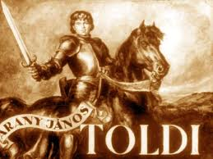
Toldi 1846
Toldi - one of his most famous works - was published, he and Sándor Petőfi became close friends. His friend's death in the Hungarian Revolution and Independent War in 1849 had a great impact on him.

Slide 43
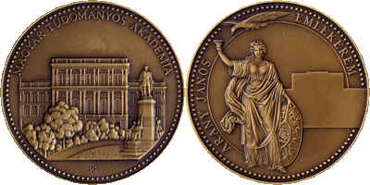
Member of the Academy - Medalion of Arany János
Arany was elected as member of the Hungarian Academy of Sciences in 1858. He was the secretary-general of the Academy from 1865. Also, he was elected director of the Kisfaludy Society, the greatest literary association in Hungary.

Slide 44
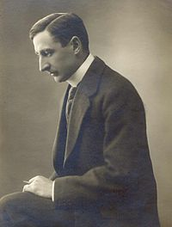
Investment into human resources – Re-founded the universities – 5,000 schools buildings were built in the whole country
(Kuno Klebelsberg; Minister of Religion and Education 1922–1931)
Hungary collapsed in 1918, after two destructive revolutions, but it was able to rebuild itself. This was the Consolidation Era, which started a giant project of investment into human resources. The new educational policy re-founded the universities, because the new border line closed any contact between the motherland and the old Hungarian University cities (Kolozsvár, Marosvásárhely, Nagyszombat, Selmecbánya etc.). More than five thousands school buildings were built in the whole country, especially in rural area for example in the Great Plain. New school building project started in the 1920’s, it was the Klebelsberg’s project, that was the “Hungarian New Deal”, but it could be a new subject of chapters or any lecture.

Slide 45
Consolidation Era 1920 - 1932
Holy Peace era
1867-1914
The Compromise
1867
Consolidation Era
1920-1932
Revolution and Independent War 1848-1849
Trianon Treaty
1920

Slide 46
LOSS project’s link: http://www.tk.mta.hu/pti/loss/
thank you your attention

